Slide 1
Reviews about Speech of the Canadian president about covid-19 vaccine
NLP Project
Shahad Abdulsalam

Slide 2
Problem & Dataset
After the speech of Trudeau ) president of Canada(
about covid-19 vaccine plan, comments start hitting from the Canadian Citizens.
Canada
health
trudeau
vaccine
Comments:

Slide 3

preprocessing
Comment Document tokens
Removing:
Stop words.
Punctiuation.
Applying:
Lemmatization

Slide 4
LDA Model
& visulaization
Start = 2, limit= 9, step=1
Number of topics: 2
has coherence score: 0.139
Number of topics 3
has coherence score: 0.285
Number of topics: 4
has coherence score: 0.2886
Number of topics: 5
has coherence score: 0.3081
Number of topics: 6
has coherence score: 0.303
Number of topics: 7
has coherence score: 0.3202
Number of topics: 8
has coherence score: 0.3077

Slide 5
CorEx model
Anchors with strength=10
[ 'plan’ , 'decide’ ]
['healthcare’ , 'health’ , 'care’ , 'children’]
['government’ , 'country’ , 'citizen’ , 'decision’ ]
['canada’ , ’US’ , 'liberal’ , ‘pay ’]
Covid plan:
plan,decide,low,distribution,version,citizens,falling,impact,sidelines,statistics.
Healthcare:
health,care,healthcare,children,workers,provinces,oil,jobs,approval,vaccines.
canadian_government:
government,country,people,example,private,playing,domestically,current,ottawa,wrong.
liberal_party:
canada,liberal,pay,vaccine,approve,foreign,production,chinese,blocked,domestic.

Slide 6
Converting data into supervised data:
Create a dataframe for topics.
Create a dataframe of tokens of the documents.
Merge the dataframes together.
Return the topics columns into a dummies variables.

Slide 7
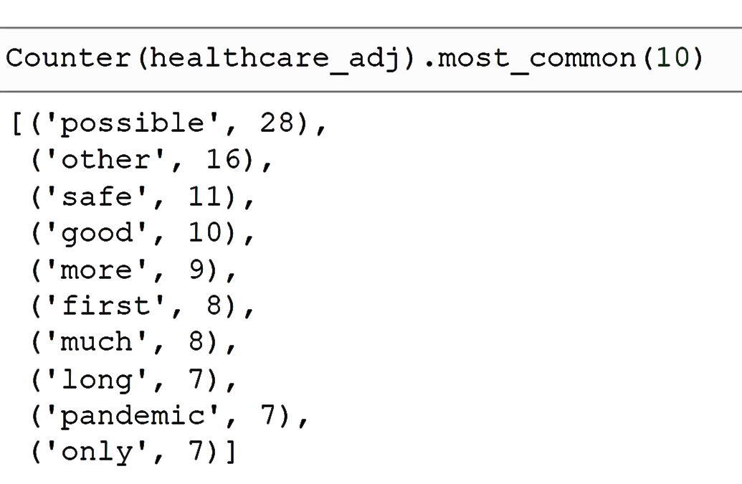
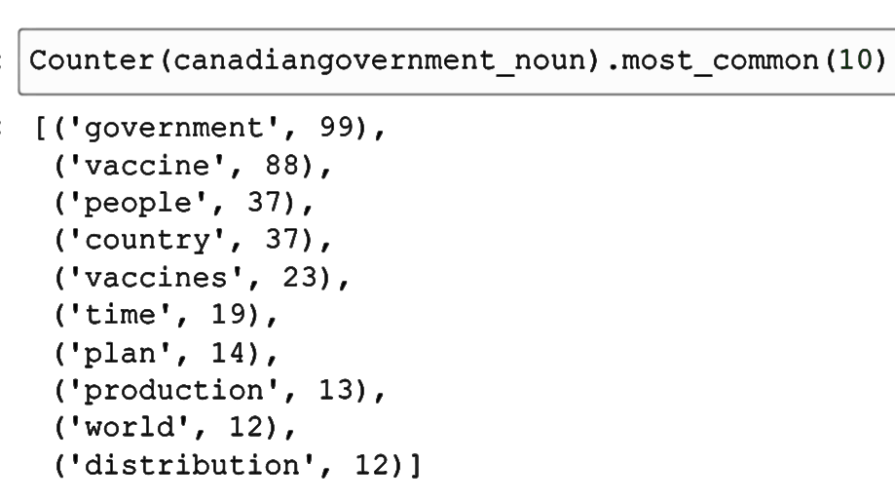
Counter & Amods:

Slide 8
THE END
THANK YOU

